Slide 1
Beautiful architecture
By jerry

Slide 2
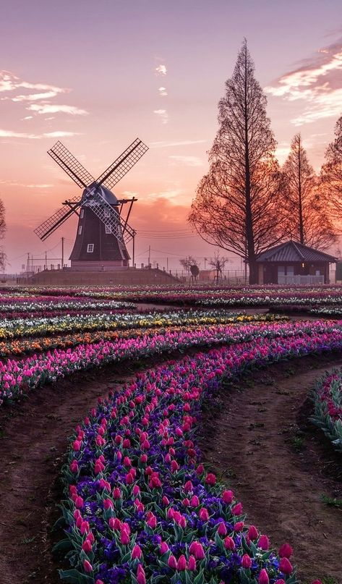
Description When I was watching sceneries both in real life and animations, such kind of beautiful views always contain a typical windmill running softly.

Slide 3
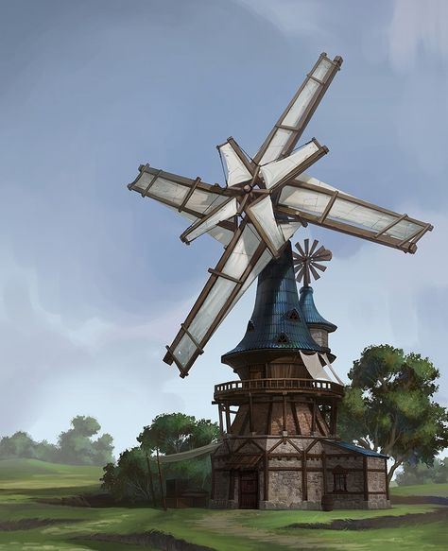
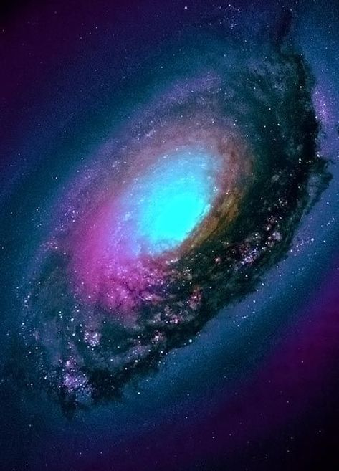

References
https://i.pinimg.com/474x/bc/9b/75/bc9b7595ac35ee98a51c352b3a671723.jpg
https://www.pinterest.com/pin/337840409558044760/
https://i.pinimg.com/474x/0c/f7/ef/0cf7ef4ffae69785a15e208ac018e02d.jpg

Slide 4
